Slide 1

PhD Committee Meeting December 2014
Kenneth Doig
ken.doig@petermac.org
Notes:
<number>
This is a talk about what we are doing at Peter Mac to move high throughput sequencing into the clinical pathology area.
We’ve built a web application called Path-OS (for pathology operating system) to manage our variants.
In contrast to a lot of the talks in this forum it’s a bit more focused on software engineering than bioinformatics.

Slide 2
Agenda
Context
Current R&D
PathOS
PipeCleaner
Variant Viewer
Development Goals
Wednesday, 2 October 2019
HUB Path-OS
<number>
Notes:
A bit of signposting…
<number>

Slide 3
The Context
Notes:
I’ll just go through some background of the project
<number>

Slide 4
Issues with pathology practices
Not scalable for NGS data generated, in the future…
Multi-gene panels: 50 – 200+ genes
Deep sequencing: low frequency variants
High throughput: 100’s samples per seq. run
More false positives
More polymorphisms
More VUS
Not scalable for analysis
People limited: the number of minutes per variant
Molecular Pathologists
Curators
Bioinformaticians
More databases
inconsistent nomenclatures, semantics and interfaces
More literature, evidence
inconsistent nomenclatures, semantics, diseases
actual variants buried in text or supplementary files
Lack of clinical quality databases
Labs aren’t depositing classified variants in the public domain
Legal risks
Commercial reasons
Laziness
If they do, can the data be trusted ?, what is the evidence recorded
Wednesday, 2 October 2019
HUB Path-OS
<number>
Notes:
So these are some of the issues with most current molecular pathology services.
Things are likely to get more complex as more is learned about disease pathology and epigenetics gets used.
It really comes down to a data filtering exercise, processing the variants and evidence in a clinically usable timeframe.
<number>

Slide 5
Aim1
To identify and articulate the technical, logistical and organisational barriers to entry for the adoption of high throughput sequencing (HTS) in a clinical oncology setting.
Aim2
To develop the methodologies and software engineering systems necessary for the processing of HTS data from sequencer through to a clinical report.
Aim3
To anticipate the possible technology directions for molecular diagnostics in cancer and develop software architectures and systems that can address future sequencing needs in a scalable manner.
Wednesday, 2 October 2019
HUB Path-OS
<number>

Slide 6
Path-OS Status
Current status
Release v0.995 – 22 releases from early 2013
44 users
Daily operational use for germline, haem. and somatic
23,071 sequenced samples, 784,766 variants
Amplicon panel focused
Key goals
Automate the processing from sequencer to draft report
Automate curation evidence collection
Sanitise data from external sources
Automated reporting
Best practice software engineering
2/10/19
Architecture
<number>

Slide 7
Path-OS
Notes:
So this is what we’ve come up with and have been using for the last 18 months
<number>

Slide 8
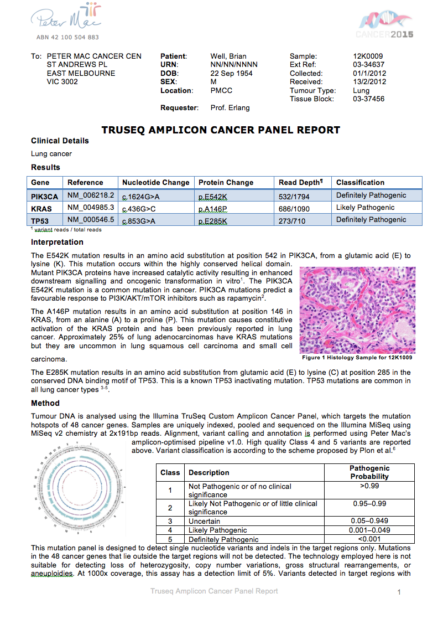
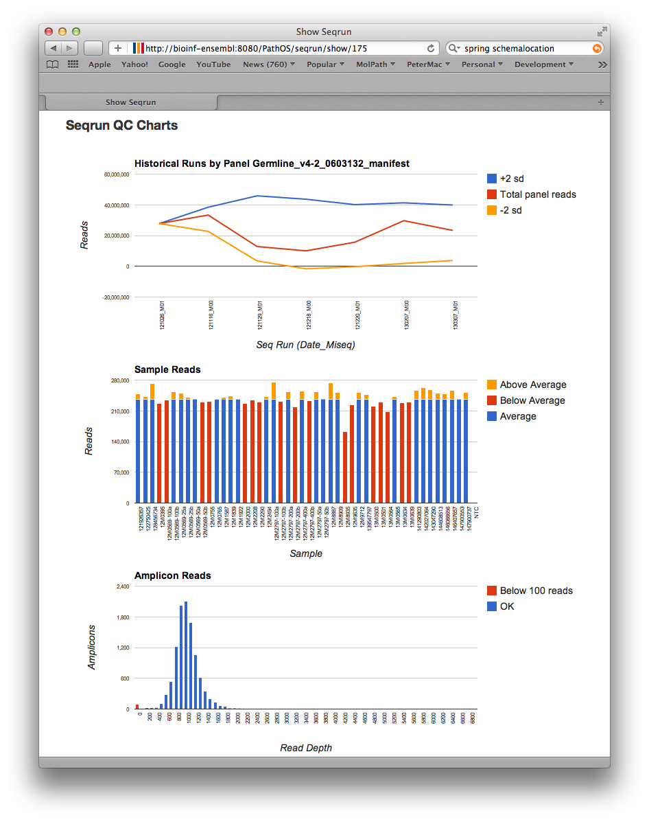
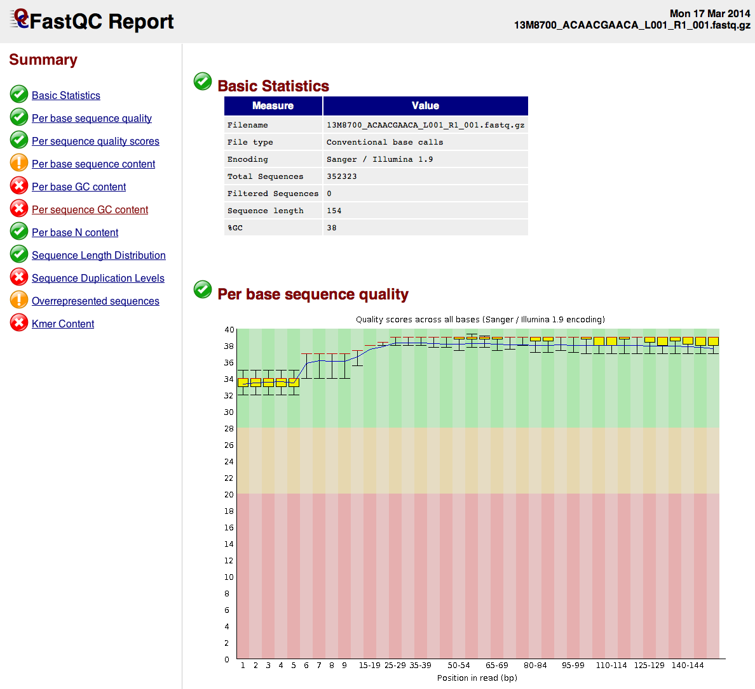


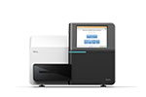


Path-OS Overview
Web Server
PathOS
Export curated variants to global repositories
External Variant DBs
COSMIC
Ensembl
Annovar
UCSC
Clinvar
etc
Clinical Reporting
Users
molecular scientists
clinicians
researchers
Filtering
configuration
Sequencing QC
ETL configuration
Loader
Periodic DB download and integration
Pipeline data repository
FASTQ
BAM
VCF
VEP
Hospital Records
Read QC
Pipeline configuration
Pipeline
PipeCleaner
Patient Sample
Synthtetic Reads
Known samples
Pipeline Validation QC Reporting
Genologics wet lab LIMS
Sequencers
Wednesday, 2 October 2019
HUB Path-OS
<number>
Notes:
Overview of the major components of Path-OS.
Samples have DNA extracted, quantified and amplified in preparation for sequencing.
After sequencing, the reads are aligned, variant called and annotated by an amplicon customised pipeline.
Following loading into the DB, the variants are curated and reported on via the web GUI
We also link into various reference datasets such as COSMIC, Ensembl and LSDBs
Variant Normalisation:
Without uniform variant naming, its not possible to automatically match a sequenced variant with external DBs and literature
We’ve built a variant normalising sub-system to make all variants uniform and compliant with HGVS
Also needed a java interface to Mutalyzer.nl web site to automatically validate nomenclature
Process involves 3 distinct phases:
Wet lab, Bioinformatics, Clinical informatics
<number>

Slide 9
Sample Data Flow
Manual Step
Automatic Step
Patient Sample
DB Load
Filtering
Peter Mac Mutation DB
External and Locus Specific DBs
Histology
Alignment
Yes
Known Variant ?
DNA Extract
Variant Calling
No
Curation
PCR
Annotation
Patient Clinical Report
Publish Report
Sequencing
Variant Normalisation
Report Editing and Signoff
Document Assembly
Wet Lab
Bioinformatics
Clinical Informatics
Wednesday, 2 October 2019
HUB Path-OS
<number>
Notes:
Samples from our patients or from external pathology services come into our lab where they’re registered
They have their DNA extracted, amplified, quantified and then ligated to primers ready for sequencing.
This is controlled by our LIMS which we’re currently implementing in Genologics.
We have 2 Illumina MiSeqs, a HiSeq and an ABI 3730 for sanger sequencing
Our bioinformatics pipeline then crunches the data and creates an annotated VCF file of variants found in each sample
These are loaded into a variant database and further enriched with external cancer and LSDBs such as Cosmic, HGMD, BIC Iarc and Ensembl
Researchers and clinicians can then filter these variants as they wish and view them via the web interface or hyperlinked 3rd party systems such as IGV
The final step is the production of a patient clinical report of mutations found, their clinical consequences and recommended therapies.
It’s this step that is less well defined and where we are putting a lot of our effort
<number>

Slide 10
Objects
etc…
Wednesday, 2 October 2019
HUB Path-OS
<number>
Notes:
This is a simplified entity relationship diagram of the PathOS objects
A patient has one or more samples such as blood or tumour
These samples may have multiple tests on them, some of which might be a NGS sequencing assay
A seqrun is the root sequencing object: a set of samples that are sequenced on a platform using a set of panels.
A sample may be sequenced multiple times in multiple runs (or even the same run) each instance generating a set of alignment statistics.
These are used to determine the quality of its sequencing data (align_stats)
Each sequenced sample generates many sequenced variants (seq_variant) which are annotated with many attributes.
These annotated variants possibly match with a manually curated variant (variant) that has curated against existing reference variants in DBs such as Cosmic and Clinvar etc
We store local copies of these databases to improve lookup speed as well as allowing them to searched by users.
<number>

Slide 11
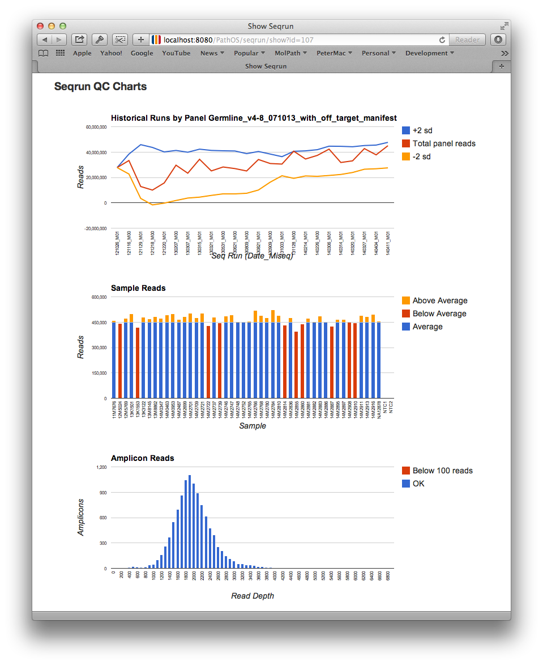
Run QC
This run in the context of past runs of the same panel
Per sample read yield highlighting below average
Amplicon performance read distribution
Wednesday, 2 October 2019
HUB Path-OS
<number>
Notes:
Quality Control is a critical part of clinical sequencing
This is a screen shot of a sequencing run showing the interactive graphs generated on-the-fly by the system.
Quality control is monitored at the sequencing run, sample and the amplicon level.
A sequencing run’s read yield is compared to all previous runs of the same panel and should be between ±2 s.d. for the last ten runs.
All samples are compared for the run and samples with below average reads are highlighted in red (middle chart).
The per amplicon reads are binned and graphed to highlight their distribution and flag any low read amplicons in red (bottom chart).
Both a sequencing run and samples within the run must be QC passed or failed prior to reports being produced.
This run has all the characteristics of a good run, close to the top of the s.d bands for the panel, uniform yield for all samples and a good distribution of amplicon reads
<number>

Slide 12
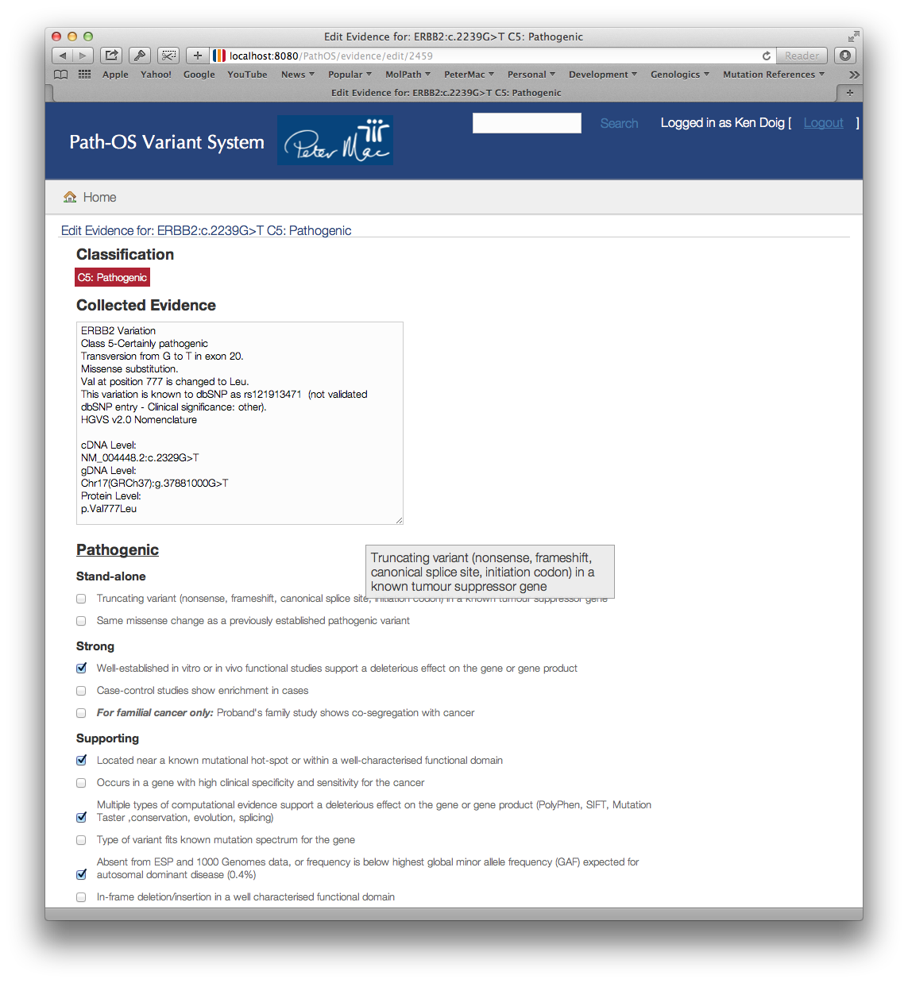
Classification Page
Automatically generated classification
Evidence type tool tip
Justification
free text field
Check boxes for variant evidence
Wednesday, 2 October 2019
HUB Path-OS
<number>
Notes:
Now I’ll just show you a screen shot to hopefully clarify how classification works.
New variants not currently in the variant database must be manually curated before they can be reported on.
This is done by assigning lines of evidence on the curation web page
The curator can select from a set of evidence checkboxes characterising the variant
Tooltips are displayed when the mouse hovers over the checkbox to guide the curators selection
The combination of checkboxes selected is used to algorithmically assign a 5-level pathogenicity class
<number>

Slide 13
Classifying variants for the clinic
Pathogenic evidence
Criteria
5 Level Classification
Stand alone
or
or
=
C5: Pathogenic
Strong
Supporting
or
C4: Likely pathogenic
=
Benign
evidence
All other combinations =
C3: Unknown pathogenicity
Stand alone
or
=
C2: Unlikely pathogenic
Strong
or
or
=
C1: Not pathogenic
Supporting
Wednesday, 2 October 2019
HUB Path-OS
<number>
Notes:
The ACMG (The American College of Medical Genetics) have released draft guidelines for mapping variant evidence into the 5-class pathogenicity scale.
We’ve adapted these guidelines and implemented the algorithm for converting lines of evidence into the five classes which we colour consistently throughout the UI
<number>

Slide 14
Software Components
Role | Package | Overview
Language | Groovy | Java on steroids, powerful JVM language
Web Framework | Grails | Rich Groovy based high productivity framework
Code repository | GitLab | Private GitHub instance
Database | MySQL | Widely adopted RDB, good performance
User interactivity | Javascript plugins | Leverage best available js e.g. Jquery, Google Charts
Object Persistence | Hibernate | Java standard for mapping POJOs to RDB
Searching | Lucene | Full-featured text search engine
IoC Layer | Spring | Java standard for inversion of control
IDE | IntelliJ | Comprehensive developers environment for Java etc
Build Management | Gradle | Groovy based DSL leverages Ant and CoC
DB Migration Mgmt | LiquiBase | DSL based data migration tool for schema versioning
Issue Management | Jira | Best of breed issue management tracker
LIMS | GenoLogics | User friendly LIMS for NGS
Aligner | Primal | Peter Mac in-house amplicon aligner, tuned for amplicons
Variant Caller | VarScan 2 | Suitable for somatic and germline (for now)
Annotation | Ensembl, Annovar | Rich set of annotations for multiple transcripts
Wednesday, 2 October 2019
HUB Path-OS
<number>
Notes:
We’ve built the system on a range of enterprise grade components which you’d find in commercial software developments (apart from the last 4 which are specific for the NGS domain)
<number>

Slide 15
Server deployment
User Site
Cloud Instance
Tomcat Web Server
Port:6000
PathOS
PathOS.war
Data
Assets
Apache HTTP Sever
MySQL DB Server
Data Repository
VCF
VEP
BAM
BED
FASTQC
Loader
Reference Data
Static Data
Patient Data
Sample Data
LIMS Data
Sequencing Data
Pipeline
Annotation
Patient Sample
Variant Call
Genologics wet lab LIMS
Alignment
Wednesday, 2 October 2019
HUB Path-OS
<number>
Notes:
This is the canonical deployment configuration for maximum flexibility with three separate servers for the application, database and the pipeline repository.
The servers can be deployed locally or remotely to minimise costs and/or data transfer bandwidth.
For example you might choose to locate the data repository close to the sequencer so you don’t shuffle massive fastq files around
or it might be cheaper to get a hosted web server rather than by a machine and maintain it and the infrastructure
But of course the application, DB and pipeline servers can all be co-located
IGV accesses the pipeline server directly to display BAM and VCF files
<number>

Slide 16
The Panels
Notes:
The technology workhorse for our clinical sequence lab is targeted amplicon panels.
PathOS supports exome and WGS sequencing but amplicons give the best tradeoff in terms of costs, specificity and turn around time.
Its critical to have a timely response to a diagnostic request so that the treating clinician can make therapeutic decisions when needed.
<number>

Slide 17
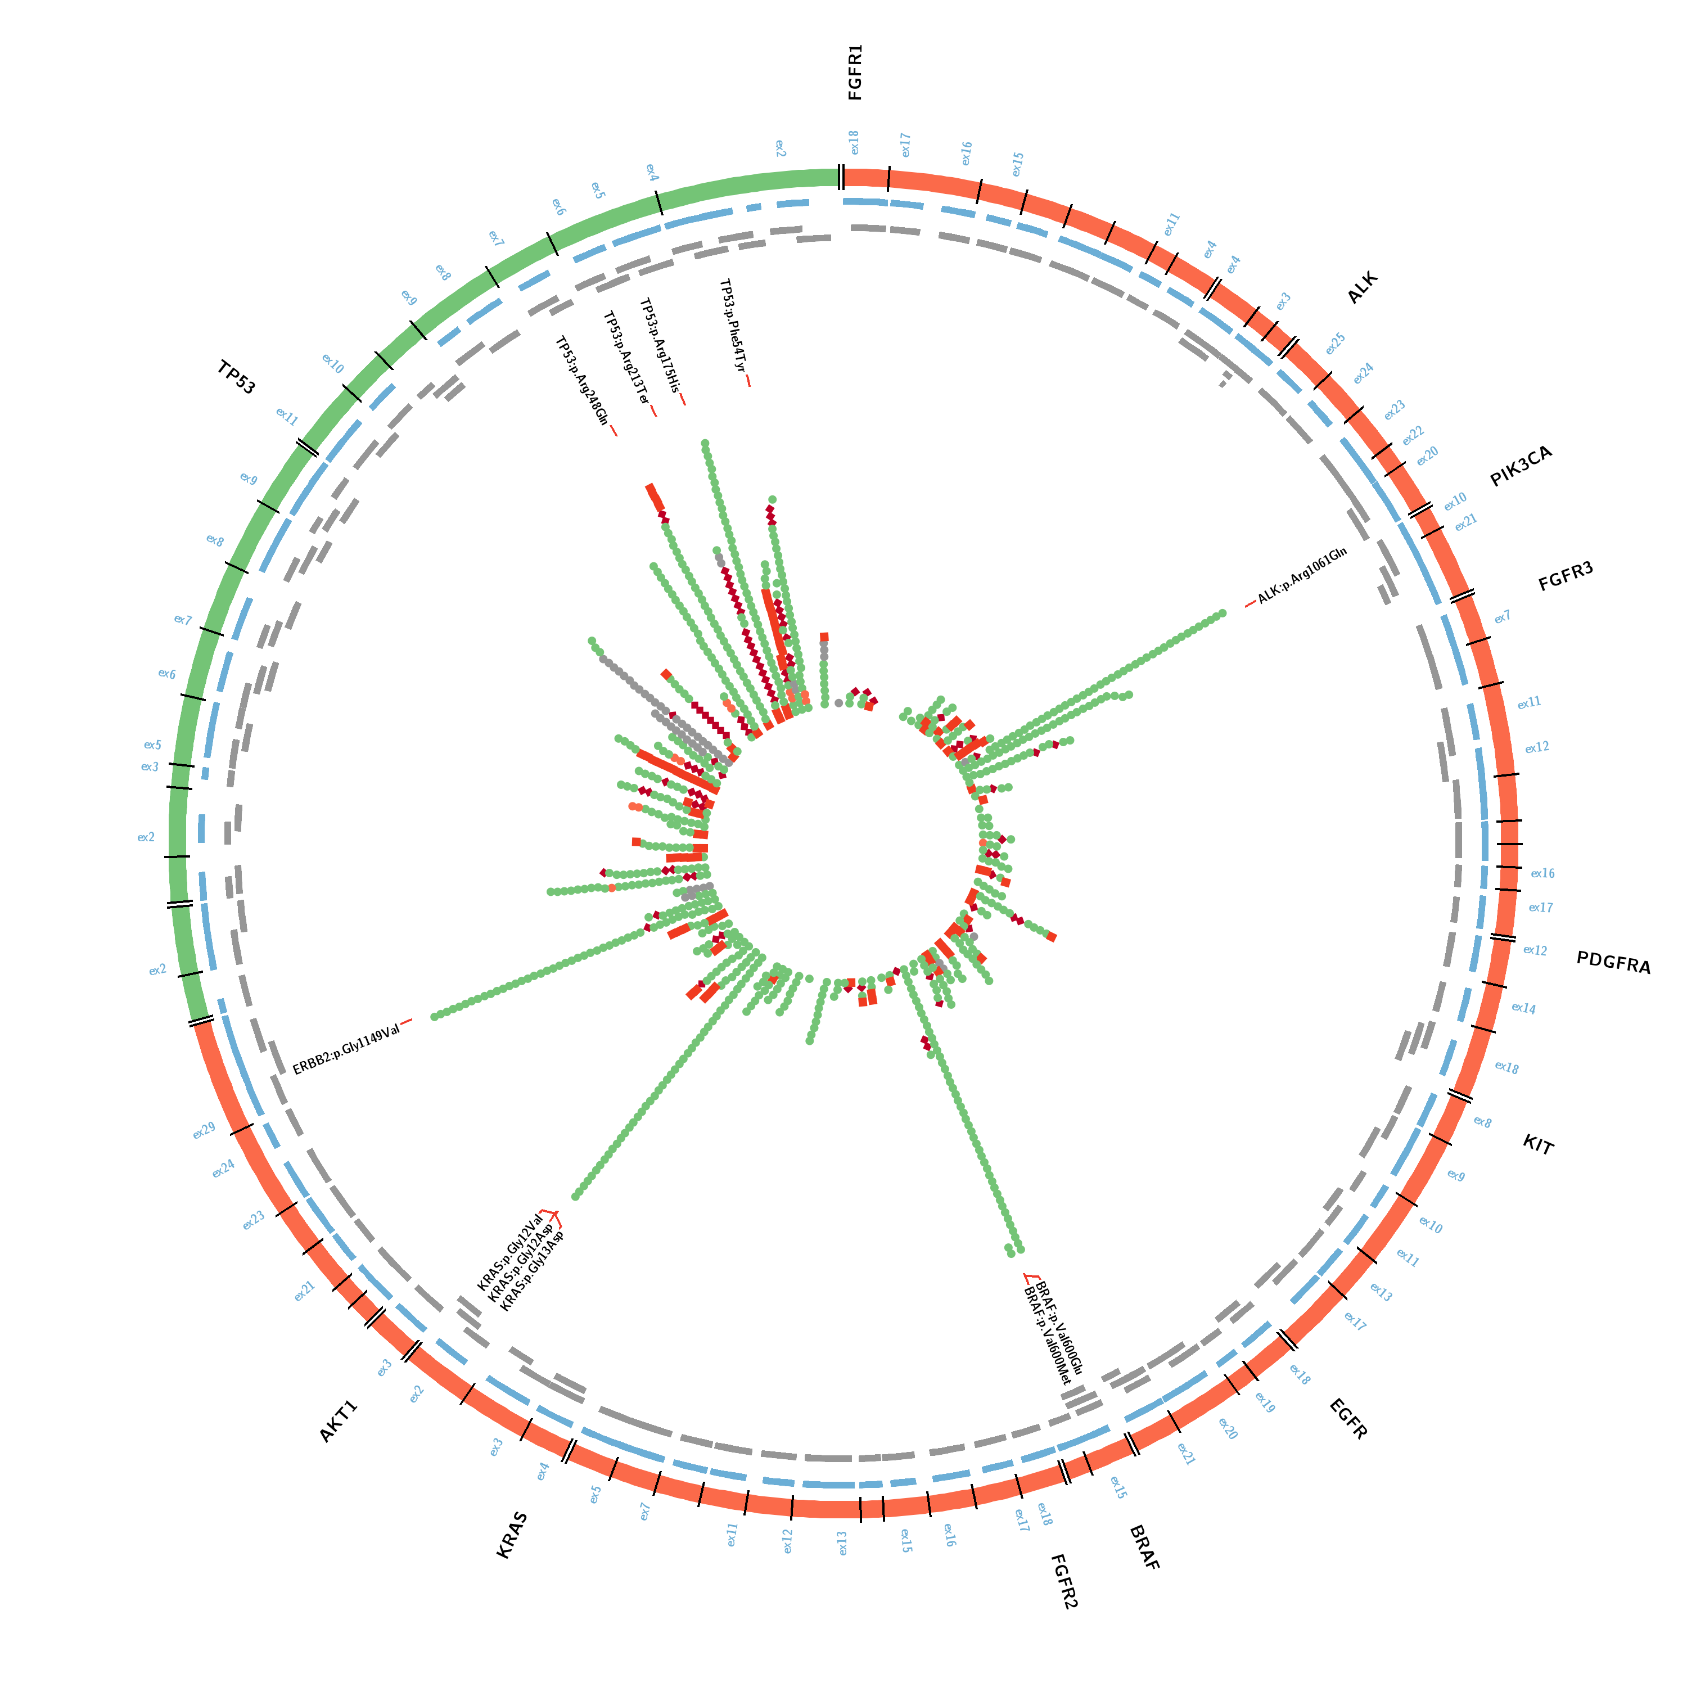
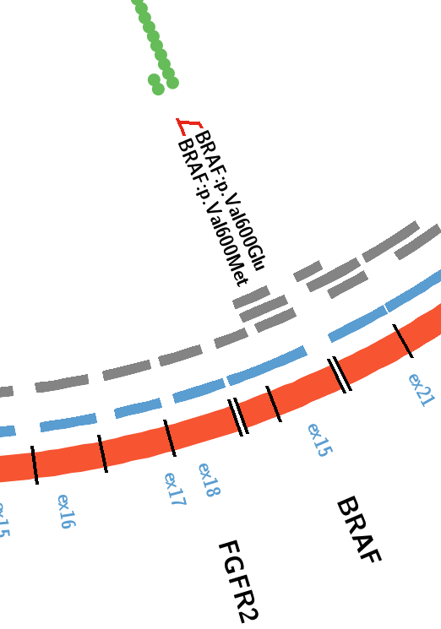
Somatic Panel
Gene type
Oncogenes
Tumour suppressors
Consequence type
Stop gained
Frame shift
Splice site
Missense
Other
Wednesday, 2 October 2019
HUB Path-OS
<number>
Notes:
The in-house somatic panel covers 12 of the common cancer oncogenes and tumour suppressors.
This panel has been designed by pathology lab to cover a custom set of genes and exons with overlapping amplicons in key regions.
The Variants are from all sequenced samples using the panel from the last 6 months or so. They are coloured and shaped based on consequence type.
You can see some loss of function variants, the stop-gained or other truncating mutations (the dark red diamond)
Particularly in TP53 which is inactivated in over 50% of cancers.
The current in-house germline panel contains BRCA 1 and 2 and TP53 and PTEN, all tumour suppressor genes. This is used for blood samples to detect familial cancers.
TruSeq:
The TruSeq panel is an off the shelf cancer panel from Illumina containing 48 cancer implicated genes using 212 amplicons.
Most of the amplicons (grey tiles) aren’t redundant which causes reliability problems.
This circos plot is generated outside of Path-OS but will be embedded in a later release so we can generate these on-the-fly
<number>

Slide 18
The Filtering
Notes:
I’d now like to take you through some of the filtering that we do to prune back the false positives that NGS dumps out.
<number>

Slide 19
Filtering Variants
Raw
Polymorphisms
Somatic
Passed
Wednesday, 2 October 2019
HUB Path-OS
<number>
Notes:
Filtering allows us to go from the top left hand side to the bottom.
The top left has a log vertical scale and is all the raw variants in Path-OS about ½ million. These consist of artefacts, polymorphism and somatic mutations
The middle shows the dbSNP annotated variants that are typically polymorphisms.
The RHS shows variant annotated as being in COSMIC so present as somatic mutations.
But after filtering, what we are left to prioritize and classify is the bottom chart with a linear vertical axis ~15,000 variants from the last 2 years of sequencing.
<number>

Slide 20
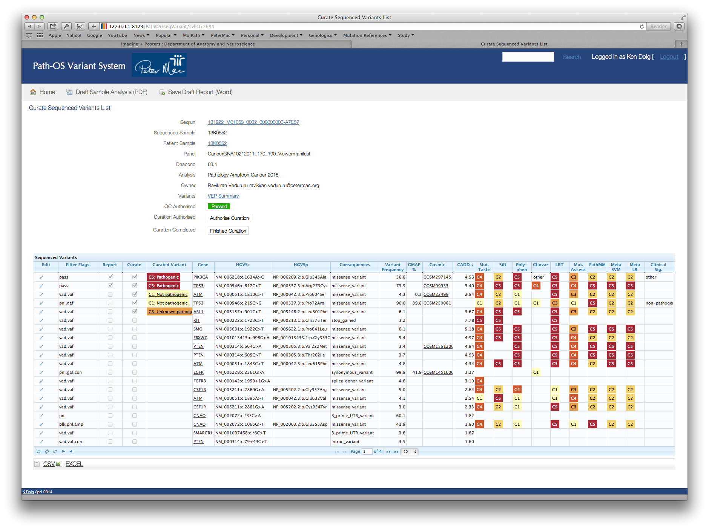
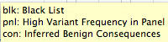
Sample Curation Page
In-silico and DB classifiers
Filter Flags
Wednesday, 2 October 2019
HUB Path-OS
<number>
Notes:
A key way of prioitising variants is by using the filter flag attributes assigned to every variant.
This screen shot shows a sample curation page with a list of variants, one per row.
We integrate about 12-15 in-silico classifiers which we categorise and colour by pathogenicity / deleteriousness
Each row has one or more filter flags assigned which can be used to find or hide categories of variants.
There is a multi clause searching dialogue at the top left (next slide)
<number>

Slide 21
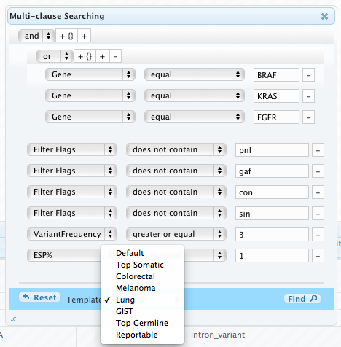
Variant Searching and Filtering
“OR” clause
Variant attribute
Predicate
Value
Template searches
Wednesday, 2 October 2019
HUB Path-OS
<number>
Notes:
The system has a comprehensive variant searching and filtering system.
Users can use templated searches (shown in the drop down box at the bottom) OR they can construct a customised multi-clause search.
This gives extremely fine control on how variants are selected and prioritised.
This particular filter looks for Lung cancer variants in these 3 genes at a variant allele frequency of > 3% but not in EVS at more than 1%
as well as removing variants with any of these 4 filter flags. (next slide)
<number>

Slide 22
Variant Filter Attributes
Filter Flag | Description | Filter Criteria
pass | Passed all filters | no filters match
vaf | Low Variant Allele Frequency | < 8% Somatic <15% Germline
vrd | Low Total Read Depth | < 100
vad | Low Variant Read Depth | < 50
blk | Assay panel specific black list | user defined
con | Inferred Benign Consequences | system defined
gmaf | High Global Minor Allele Frequency | > 1%
pnl | High Variant Frequency in Panel | > 50%
sin | Singleton variant in duplicate sample for run | Not in both samples
amp | Uneven read distribution across amplicons | Single amp. bias
Multiple filter flags may be assigned per variant
Wednesday, 2 October 2019
HUB Path-OS
<number>
Notes:
These are the currently used automatic filters that are applied to variants.
Filtering criteria can be defined on a per panel basis by administrators.
Filtering is only for prioritising variant and both unfiltered and filtered variants can all be curated and reported on.
We found that the parameters need to be technology specific
eg a different set of black listed variants is needed for Haloplex panels compared to TruSeq panels and different again for in–house panels.
So for a variant to be given a “pass” filter flag it doesn’t meet any of the criteria in the last column.
<number>

Slide 23
Filter effects
Wednesday, 2 October 2019
HUB Path-OS
<number>
Notes:
To verify that the filters were taking us in the right direction we looked at CADD (Combined Annotation Dependent Depletion) scores as a measure of pathogenicity and hence more likely to be reported on.
PathOS annotates each variant with the top 20% of CADD score where the larger the value, the more likely the variant is deleterious.
These show the mean CADD scores for the variants that have scores. We partitioned the set into a passed filter set (red) or a failed set (blue).
These categories show the amount of enrichment you get from applying the filter. The last columns compares a curator assigned reportable category against the average of all filtered variants.
<number>

Slide 24
PipeCleaner
Notes:
I’d now like to take you through some of the filtering that we do to prune back the false positives that NGS dumps out.
<number>

Slide 25
Problem Statement
There is a need to benchmark NGS pipelines against known input data to ensure the pipeline meets expectations
Simulate sample heterogenity
Tumour/Normal
Tumour heterogenity
Simulate sample quality eg FFPE
Simulate sequencer characteristics
Paired / single, read length, quality across read etc
Goals:
To generate synthetic reads that match the expected output from a sample and sequencer
To run the reads through a pipeline being tested
To compare the synthetic input reads with the pipeline variant calls
To generate false positive lists, false negative lists and understand pipeline sensitivity
Wednesday, 2 October 2019
PipeCleaner
<number>

Slide 26
The problem with NGS tools
Tools built by researchers not sw developers
Lab centric not organisation centric
Built to achieve a near term task
Not designed as an end in itself
Scripting in pref. to HLL – speed of reaching goal not longevity
rarely type safe
poor behaviour under novel conditions
Poor documentation – incode and external
Usually unmaintainable – except for original development group
Best efforts support
Often not optimised for speed, memory or disk
Task specific – limited abstraction for larger goals
Poorly designed configuration parameters
poor defaults
bazillion options (often the legacy of original testing)
Wednesday, 2 October 2019
PipeCleaner
<number>

Slide 27
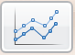
PipeCleaner
SNPs, indels (VCF file) and polymorphisms
Test Controller
test genomes
“mutated” genomes
Variant Generator (pc-vcfgen)
Read Generator
(pc-readsim)
Result Comparator
test log
simulated read data
Pipeline Under Test
Pipeline results: variant calls
assemblies
alignments
reference genomes
(if mapping to reference)
Wednesday, 2 October 2019
PipeCleaner
<number>

Slide 28
Types of Testing
Unit testing
built-in to IDE eg IDEA/J Builder
Integration testing
integrate early and integrate often
Regression testing
after any system/data/ change
rebuild (make, ant) each night
regression test each night
Functional testing
define all characteristics of pipeline / curation
Load/Performance testing
scalability of system for data vaolumes
scalability for user base growth
Catch-22
You only test for things that should work
Wednesday, 2 October 2019
PipeCleaner
<number>

Slide 29
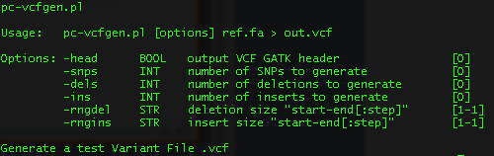
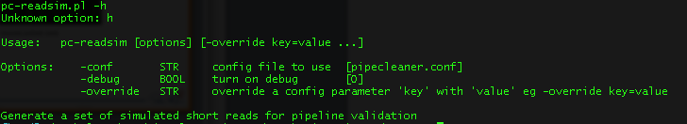
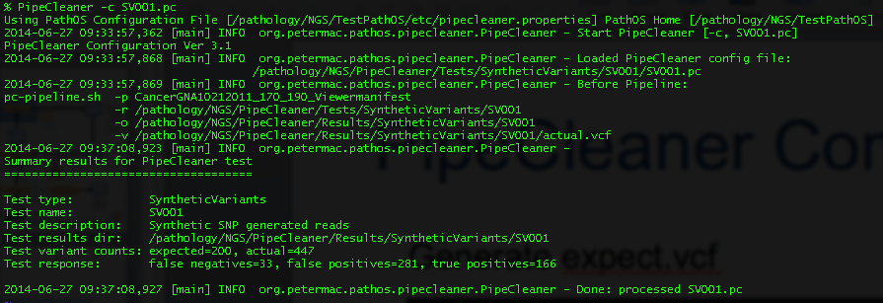
PipeCleaner Components
Generate
expect.vcf
Generate
synthetic
reads
Run the test
on PipeCleaner
Wednesday, 2 October 2019
PipeCleaner
<number>

Slide 30
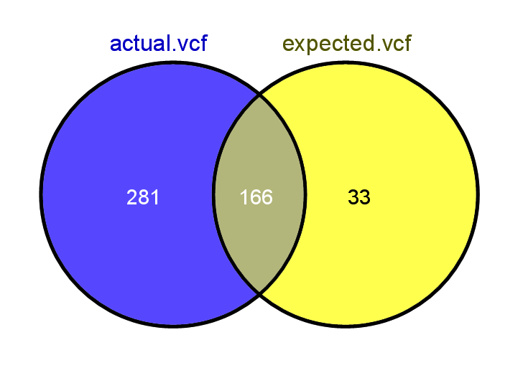
PipeCleaner Results
FalsePositive.vcf
FalseNegative.vcf
TruePositive.vcf
Wednesday, 2 October 2019
PipeCleaner
<number>

Slide 31
Data flow
Patient Sample
Sequencer
known.fastq.gz
expect.vcf
+
pc-vcfgen
Synthetic samples
Known samples
OR
expect.vcf
PipeCleaner
PipeCleaner configuration
pc-readsim
Read Simulator configuration
Pipeline Under Test
synthetic.fastq.gz
expect.vcf
actual.vcf
PC Reporting
FalsePositive.vcf
TruePositive.vcf
FalseNegative.vcf
Wednesday, 2 October 2019
PipeCleaner
<number>

Slide 32
VariantViewer
Notes:
<number>

Slide 33
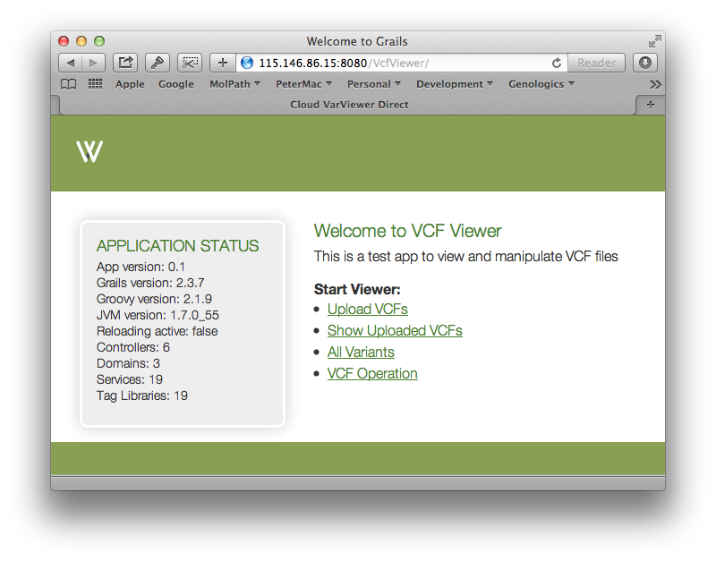
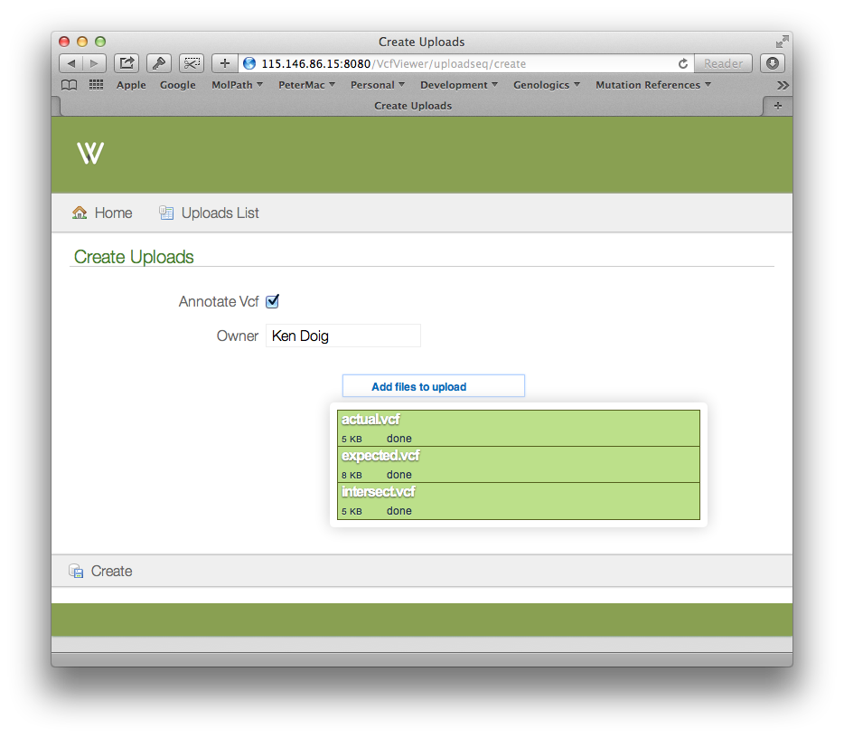
Cloud Version
Wednesday, 2 October 2019
PipeCleaner
<number>

Slide 34
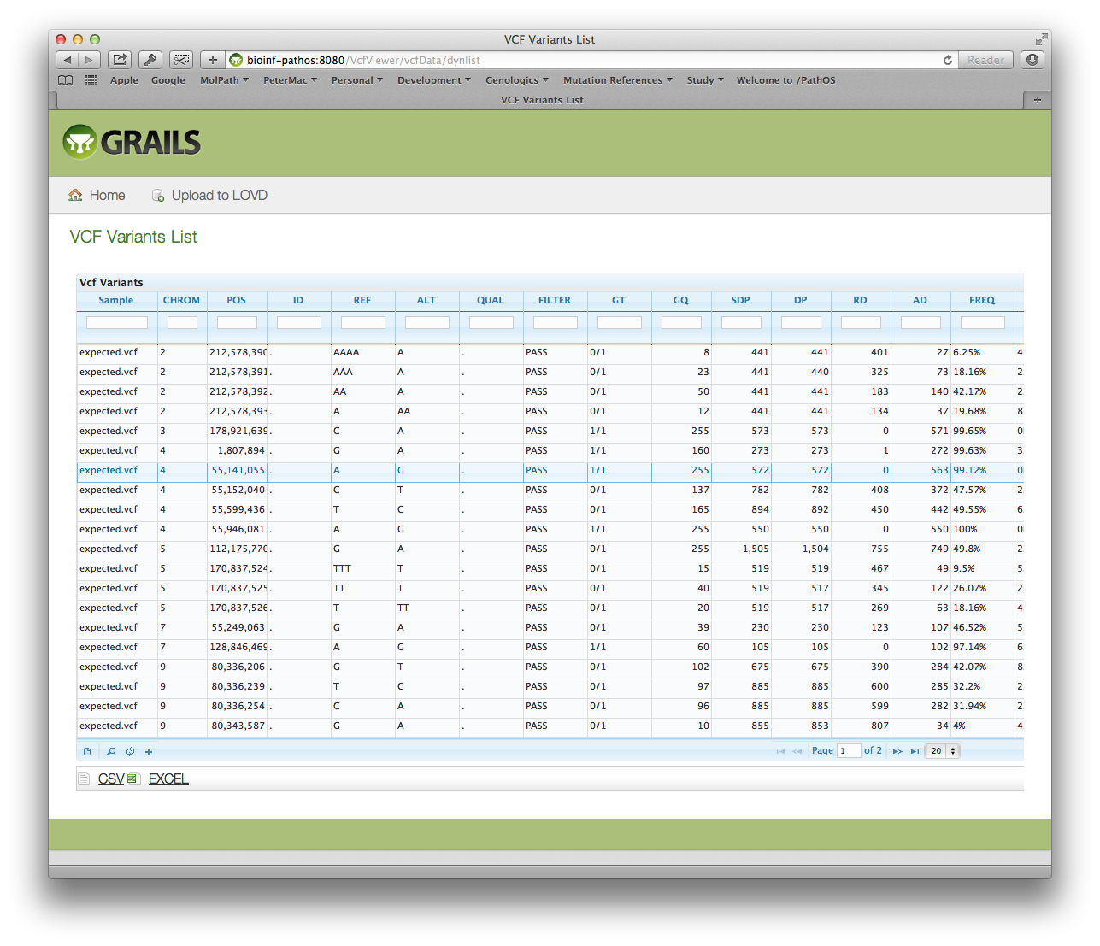
Cloud Version “PathOS-lite”
Todo List
Embedded JS browser
Multi-sample VCFs
gVCF support
Export VCF files
Add user annotations
Automatic annotation
Publicise availability
Wednesday, 2 October 2019
PipeCleaner
<number>

Slide 35
The Future
Notes:
<number>

Slide 36
In the Pipeline…
Pluggable modular pipelines (using bpipe)
Upload existing FASTQ, BAM and VCF files
PipeCleaner for Pipeline validation
Include CNV and fusion modules
Drugability of variants and clinical trials
Write paper…
Wednesday, 2 October 2019
HUB Path-OS
<number>
Notes:
We use Jira for issue tracking and feature management and the current estimate of pending work is nearly 3000 hours.
<number>

Slide 37
Towards automated curation
Four key dimensions for a variant
Artifact Score: assay specific probablity
Resulting from technical errors in panel processing
Free of technical errors in panel processing
Database/Literature Score: categorical/qualitative
No known occurrences in data sources
Expert curated in multiple databases
Pathogenicity Score: context specific probability
Benign
Pathogenic
Actionability Score: categorical/qualitative
No known therapy for this variant
PBS approved therapy or open clinical trial
Wednesday, 2 October 2019
HUB Path-OS
<number>
Notes:
<number>

Slide 38
Key Targets (2015)
Pluggable pipeline with dockerised deployment
Pluggable data source federator for scalable annotation
Drug / therapy data sources
Clinical trial data sources
Sample cohorts and relationship graphs (eg pedigrees)
PipeCleaner™ for pipeline profiling and comparison
VcfViewer light weight variant annotator
Social networking curation
Pipeline artifact modeling for panels
2/10/19
Architecture
<number>

Slide 39
Sequencing 5 years out
Scalability in every dimension
read length (46 reads with no errors !)
single molecule sequencing
larger regions, more genes, more depth, W[EG]S
more biopsies per patient
liquid, spatial, temporal
ncRNA
scalable compute resources
on-demand processor instances
cloud based resources
outsourced IT
2/10/19
Architecture
<number>

Slide 40
Sequencing 5 years out (cont.)
hg20, hg21
Multiple haplotypes
Multiple ethnicities
reference genomes are graphs not linear
streaming sequencers
lossy compression of sequencer data eg CRAM format
feedback loop from bioinformatics to sequencer
2/10/19
Architecture
<number>

Slide 41
Sequencing 5 years out (cont.)
Data sources
No one DB to rule them all
fragmented data -> pluggable data federation
larger coverage – more genes, more variants
richer phenotype attributes
Allow for arbitrary key-value pairs for all objects
2/10/19
Architecture
<number>

Slide 42
Sequencing 5 years out (cont.)
Scalability of human resources
Virtual tumour board
Harness distributed expertise asynchronously
Multi media interaction
Thresholding attributes - “traffic lights”
Tune cutoffs to match work force
Clearly ‘in’ -> automate
Attribute
value
Ambiguous -> manual assessment
Clearly ‘out’ -> automate
2/10/19
Architecture
<number>

Slide 43
Sequencing 5 years out (cont.)
Illumina will own Everything !
this is NOT a good thing
Commoditisation will go from the sequencer upstream
We are still a cottage industry
Engineering rigour is needed to keep pace
Software engineering
Robotics automation
Scalable processes
Technologies churn, but biology doesn’t
2/10/19
Architecture
<number>

